Slide 1
From Source Code to Packages and even whole distributions
By Cool Person
From openSUSE
Notes:
One of the challenges for Linux software developers is the need to compile software to run on various Linux platforms. Usually, this means that you need to have each of the distributions (in several versions!) you want to support, and build binary packages for each platform — a labour-intensive process. While there are some standards like Linux Standards Base which should mitigate the situation, you usually still bump into non-standard names for dependencies and many other issues. Now there is a solution: the Build Service.

Slide 2

OBS – The openSUSE Build Service
builds binary packages for many distributions and platforms and lets users download them
Automatically rebuilds packages if needed
Allows to work together in 'projects' and teams
Is accessible through web interface or commandline
Is completely Free Software and developed in the open
Can be installed on your own infrastructure
Works with app stores (OCS)
Notes:
* the openSUSE Build Service is a server platform for building packages. The OBS at build.opensuse.org is currently used by the openSUSE developers to build the whole distribution, as well as much more. OBS has both a web and a commandline interface and has become quite a powerful piece of software which is now adopted by other projects.
* build.opensuse.org only supports x86, windows is experimental but MeeGo and other communities and companies use OBS for mobile (ARM) already. All major linux distributions supported: Fedora/Red Hat/CentOS, Ubuntu (incl LTS) and debian, openSUSE and SLE, Mandriva and more. OBS also has building of live/install CD's build in.
* OBS can get source code directly from GIT, SVN, CVS etc. Automatically rebuilds packages when dependencies change to avoid ABI issues; can rewrite dependency names for different distro's; can rebuild packages automatically if source code repository changes; and automatically rebuild live/install CD's if any of it's packages changes
* In projects teams can work together on a subset of packages. Has maintainers, access rights, merge requests etc etc
* Web interface (build.openSUSE.org) is easy to use; oSC commandline client offers a little bit more functionality. Builds about 100,000 packages from 25,000 users working on 15,000 different projects
* Developed together with Intel, Nokia, Linux Foundation, Cray and many others
* You can dowload a liveCD to test running OBS; OBS instances can connect to each other. Used by MeeGo, Cray, VLC and many others to build anything from packages up to complete distributions.
* OBS supports the Open Collaboration Services (freedesktop.org spec) to make it easy to integrate with app stores. openSUSE project Bretzn is working on integrating in appstores like gtk-apps.org, kde-apps.org, MeeGo Appstore and more

Slide 3
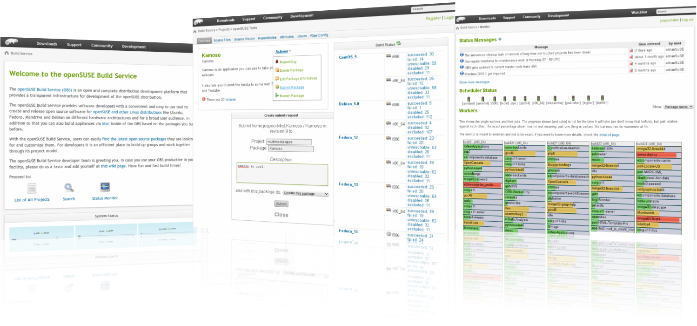
Notes:
Here you see OBS, in the center doing a merge request and to the right the build status - many packages are currently building. To build a package, OBS creates a clean Virtual Machine (with the right OS and architecture of course) and then installs all dependencies and does a clean build of the package. Thi ensures consistency and stability of the resulting packages. Any compilation errors are fed back to the developers!
The web interface of OBS is very powerful - the whole process of building and contributing packages can be done from a webbrowser - yes, you can contribute to openSUSE from a slow netbook with Windows on it!

